Slide 1

Business with the Third World

Slide 2
The Third World is the developing countries of Asia, Africa, and Latin America
(Oxford English Dictionary)

Slide 3
Review of Utilitarianism
When multiple actions are available, Utilitarianism obligates the individual to take the action that
maximizes net aggregate happiness

Slide 4
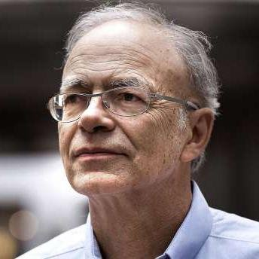
Peter Singer
Famous utilitarian philosopher

Slide 5
Peter Singer
Famous utilitarian philosopher
Animal liberation activist

Slide 6
Peter Singer
Famous utilitarian philosopher
Animal liberation activist
1971 author of
“Famine, Affluence, and Morality”

Slide 7
“Famine, Affluence, and Morality”

Slide 8
“Famine, Affluence, and Morality”
“Constant poverty, a cyclone, and a civil war have turned at least nine million people into destitute refugees.”

Slide 9
“Famine, Affluence, and Morality”
“Constant poverty, a cyclone, and a civil war have turned at least nine million people into destitute refugees.”
“Australia is another country which, on a per capita basis, is well up in the "aid to Bengal" table. Australia's aid, however, amounts to less than one-twelfth of the cost of Sydney's new opera house.”

Slide 10
“Famine, Affluence, and Morality”
“The decisions and actions of human beings can prevent this kind of suffering. Unfortunately, human beings have not made the necessary decisions.”

Slide 11
“Famine, Affluence, and Morality”
“The decisions and actions of human beings can prevent this kind of suffering. Unfortunately, human beings have not made the necessary decisions.”
So, people in affluent nations did not do what utilitarianism obligates them to do.

Slide 12
“Famine, Affluence, and Morality”
Affluent people have a responsibility to care for the needy, which they are failing to meet.

Slide 13
International Markets

Slide 14
International Markets
Labor is cheaper in the Third World than in the United States
So Third World workers are willing to work for less pay
to minimize labor expenses, a lot of corporations that are based in the United States hire labor in the Third World

Slide 15
International Markets
(Oxford English Dictionary)
A sweatshop is a factory or workshop, especially in the clothing industry, where manual workers are employed at very low wages for long hours and under poor conditions

Slide 16
International Markets
(Oxford English Dictionary)
A sweatshop is a factory or workshop, especially in the clothing industry, where manual workers are employed at very low wages for long hours and under poor conditions
So some sellers advertise that their products are “sweatshop free”

Slide 17

International Markets
Paul Krugman
1997 “In Praise of Cheap Labor”

Slide 18
“In Praise of Cheap Labor”
“And yet, wherever the new export industries have grown, there has been measurable improvement in the lives of ordinary people”
“While fat-cat capitalists might benefit from globalization, the biggest beneficiaries are, yes, Third World workers”

Slide 19
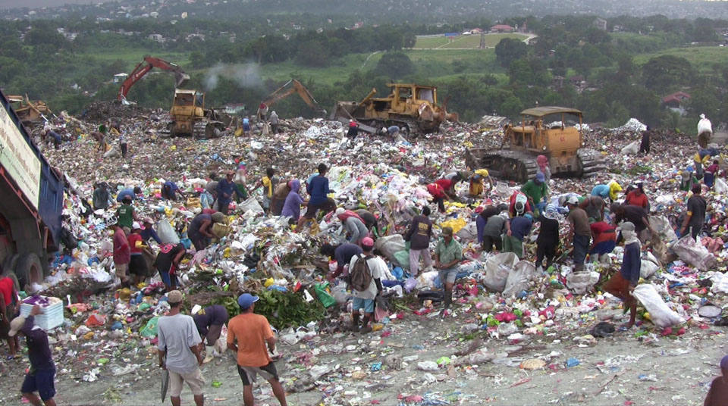
“In Praise of Cheap Labor”
“Smokey Mountain”

Slide 20
“In Praise of Cheap Labor”
“Smokey Mountain”
Several thousand people made a living by rummaging through garbage
A scavenger made about $10 per day by turning in recyclables

